Slide 1
Accessing and Using the Data Collection & Reporting (DCR) System
HSRC
February 10, 2010

Slide 2
MHSA Full Service Partnership Forms & Methodology

Slide 3
Outcomes Data Collection
The target population for individual outcomes data collection is based on four age groupings as specified in the Community Services and Supports (CSS) Plans
Youth (ages 0-15)
Transitional Age Youth (ages 16-25)
Adults (ages 26-59)
Older Adults (ages 60+)
Separate forms were developed for each of the four age groupings

Slide 4
MHSA FULL SERVICE PARTNERSHIP FORMS
History/Baseline data:
Partnership Assessment Form (PAF) –
Typically completed ONCE, when partnership is established (Exception: interruption in services)
Follow-Up data:
Key Event Tracking Form (KET) –
Completed when change occurs in key areas
Quarterly Assessment (3M) –

Slide 5
PARTNERSHIP ASSESSMENT FORM
Residential History (includes hospitalization & incarceration): Where the partner is sleeping now, where he/she was sleeping last night and where he/she has been living for the past 12 months
Education: Highest level of education, current and past school attendance and grades, current and past participation in other types of educational settings
Employment: Current and past participation in various employment settings, average hourly wages and average hours worked per week now and over the past 12 months
Sources of Financial Support: Current and historical source of financial support
Legal Issues/Designations: Current and historical involvement with the legal and criminal justice system, foster care status, custody status of children
Emergency Intervention: Number of physical health-related and mental health/substance abuse-related emergency interventions over the past 12 months
Health Status: Whether the partner has or had access to a primary care physician over the past 12 months
Substance Abuse: Whether the partner has a co-occurring mental health/substance use problem and whether they are receiving treatment for their substance use issues.

Slide 6
KEY EVENT TRACKING FORM
Completed when there are changes in any of the following key areas:
Administrative Information: Such as changes in partnership status (discontinuations or interruptions) or changes in FSP or other program participation
Residential (includes hospitalization and incarceration): Such as whenever a partner moves from a residential setting or moves from one physical location to another
Education: Such as when a partner completes a grade, is suspended or expelled or when he/she enrolls or stops attending other types of educational settings
Employment: Such as changes in hours, hourly wages, or type of employment settings
Legal Issues/Designations: Such as when a partner is arrested, removed or placed on probation or parole, or placed or removed from conservatorship or payee status
Emergency Interventions: Whenever a partner received any type of physical or mental health/substance abuse related emergency intervention

Slide 7
QUARTERLY ASSESSMENT FORM
Completed every 3 months to assess:
Education: Assesses current attendance level and grades, and whether the partner is currently receiving any type of special education
Sources of Financial Support: Assesses current sources of financial support
Legal Issues/Designations: Assesses current custody arrangements for children of the partner
Health Status: Assesses current access to a primary care physician
Substance Abuse: Assesses whether the partner is currently considered to have a co-occurring mental illness and substance use problem and whether the partner is current receiving substance abuse services

Slide 9
Additional Timeline Information
If there has been an interruption in a partner’s services for LESS THAN ONE YEAR, then KETs would be completed to indicate the key events that occurred during the lapse in time.
If the interruption in a partner’s services has lasted for MORE THAN ONE YEAR, then another PAF would be completed.

Slide 10
Recap
FORMS AVAILABLE FOR 4 AGE GROUPS:
Child/Youth (ages 0-15)
Transition Age Youth (ages 16-25)
Adults (ages 26-59)
Older Adults (ages 60+)
3 TYPES OF FORMS:
Partnership Assessment Form
completed ONCE, when the partnership is established (Exception: interruption in services)
Key Event Tracking Form
completed EACH TIME THERE IS A CHANGE in a key event
Quarterly Assessment Form
completed EVERY THREE MONTHS, starting from the date the partnership was established

Slide 11
Accessing The DMH Data Collection And Reporting System (DCR)

Slide 12
Gaining Access to the DCR
All security to the DCR is managed through the DMH Information Technology Web Services (ITWS).
All users who access the DCR MUST be enrolled into the ITWS with permission to access the DCR Application.
Permission to access the DCR is managed by each county’s Approver Designee(s). Approver Designees are county employees who have been authorized to coordinate and maintain county user access to the DCR Application.
FSP Approver – Bret Vedder

Slide 13
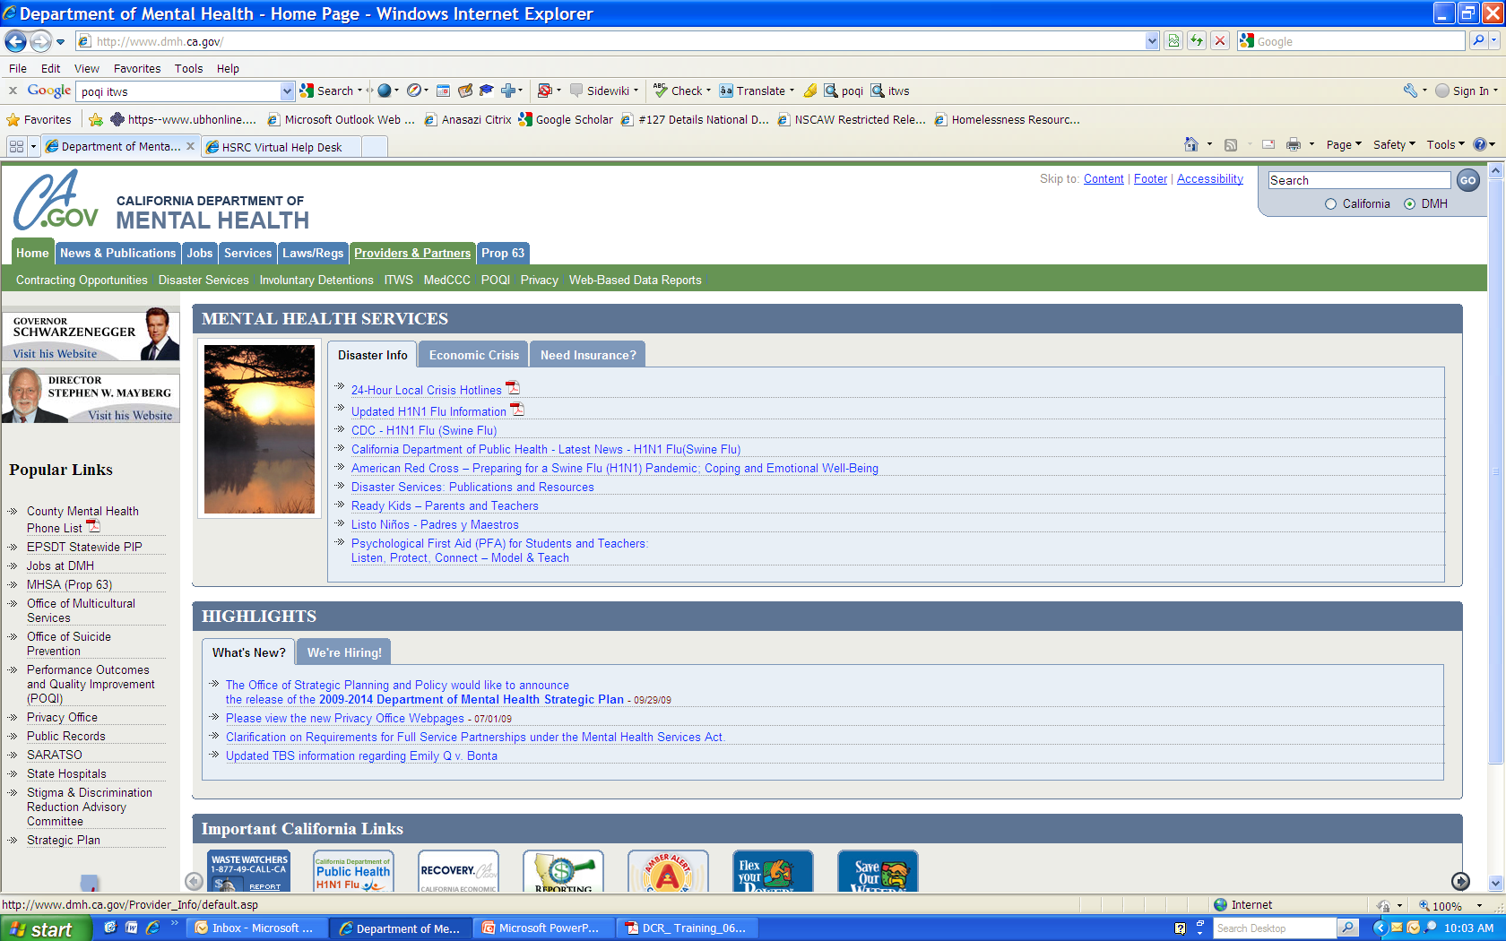
Go to the DMH Main page at www.dmh.ca.gov
On the Providers & Partners tab, select ITWS

Slide 14
New to ITWS?
How to enroll in ITWS

Slide 15
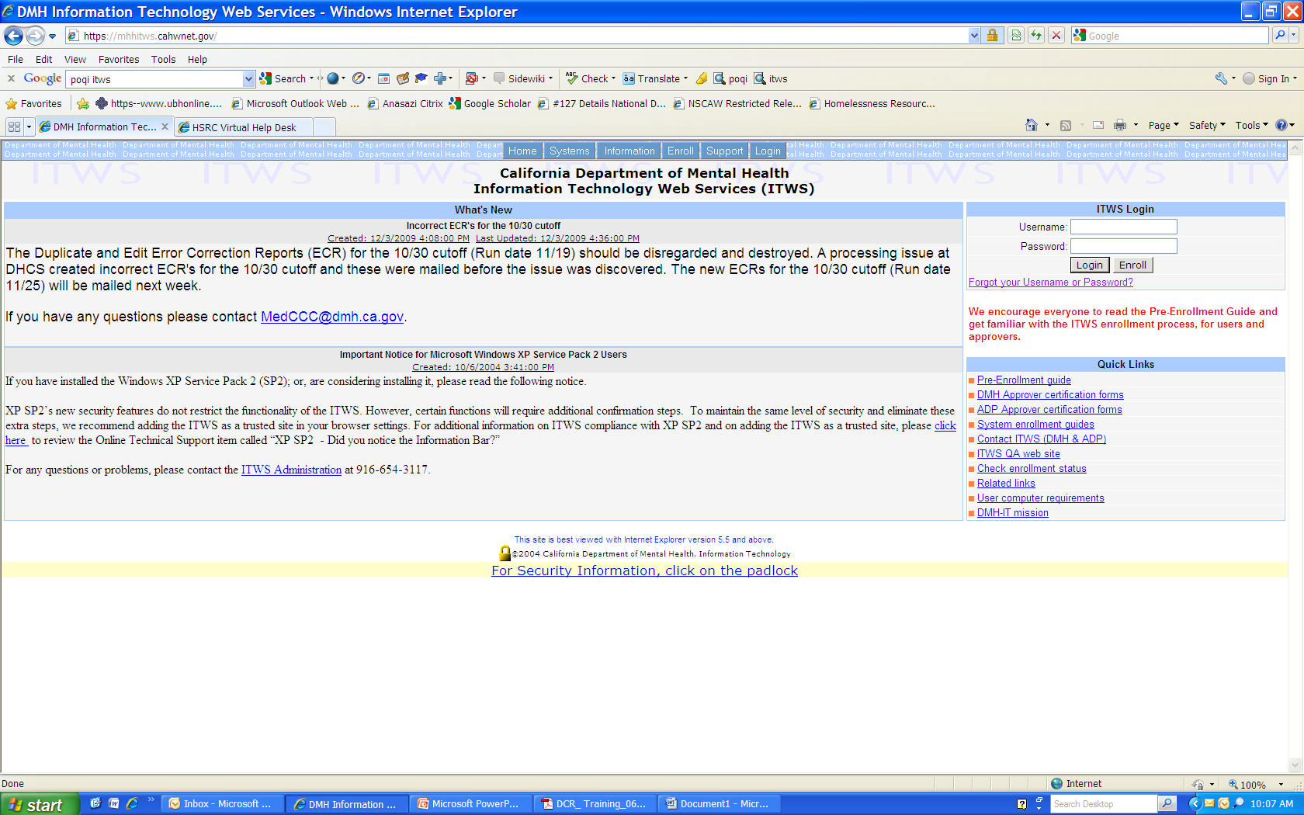
Click on Enroll

Slide 16
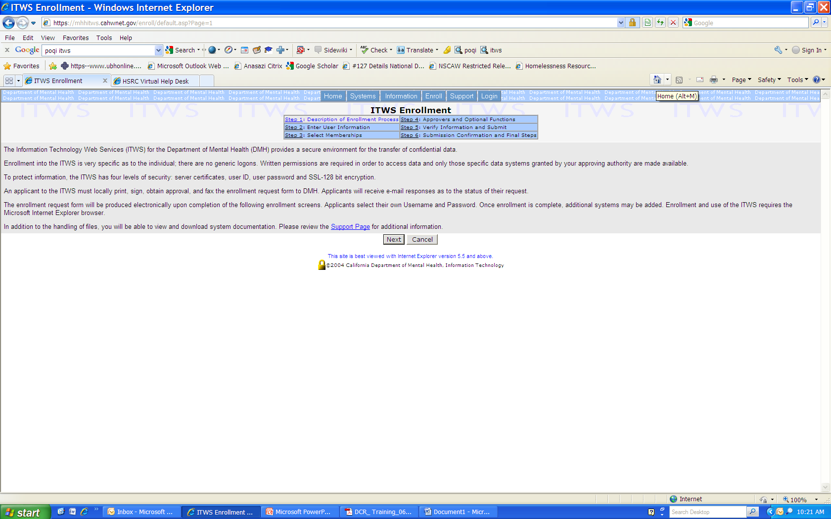
6 Steps to enroll

Slide 17
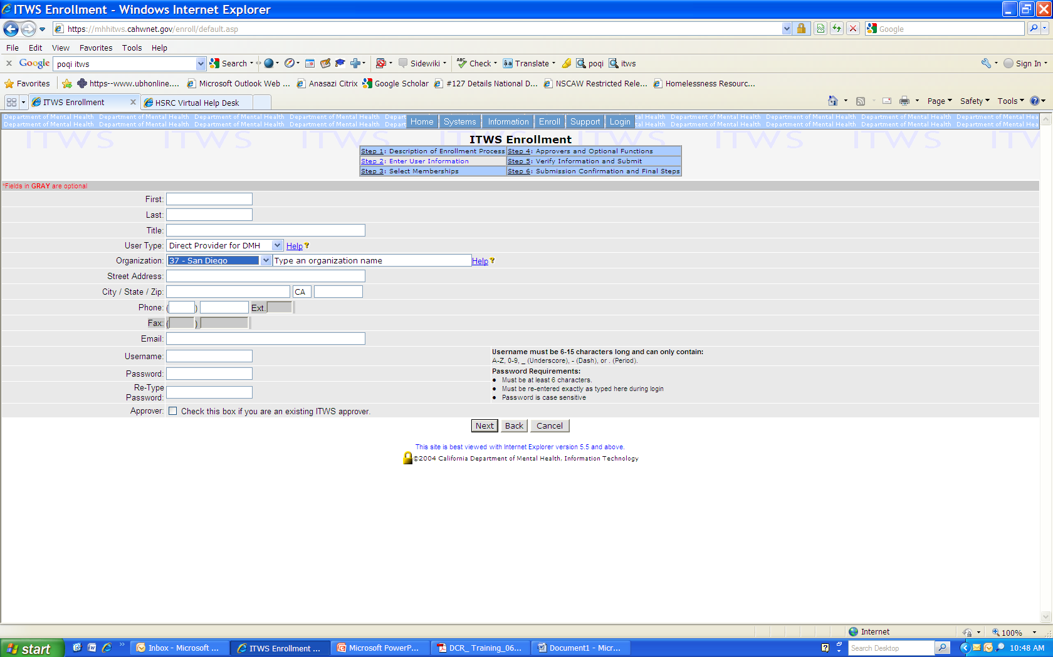
Enter your Information
User type: Direct Provider for DMH
Organization: 37 – San Diego
Type in your organization name

Slide 18
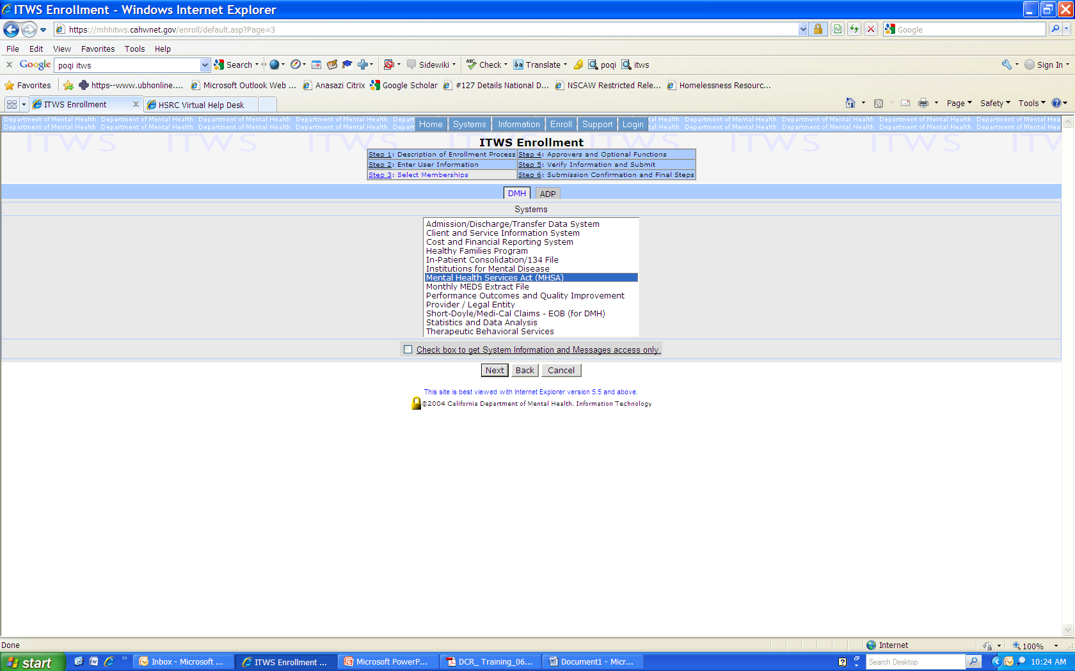
Select MHSA

Slide 19
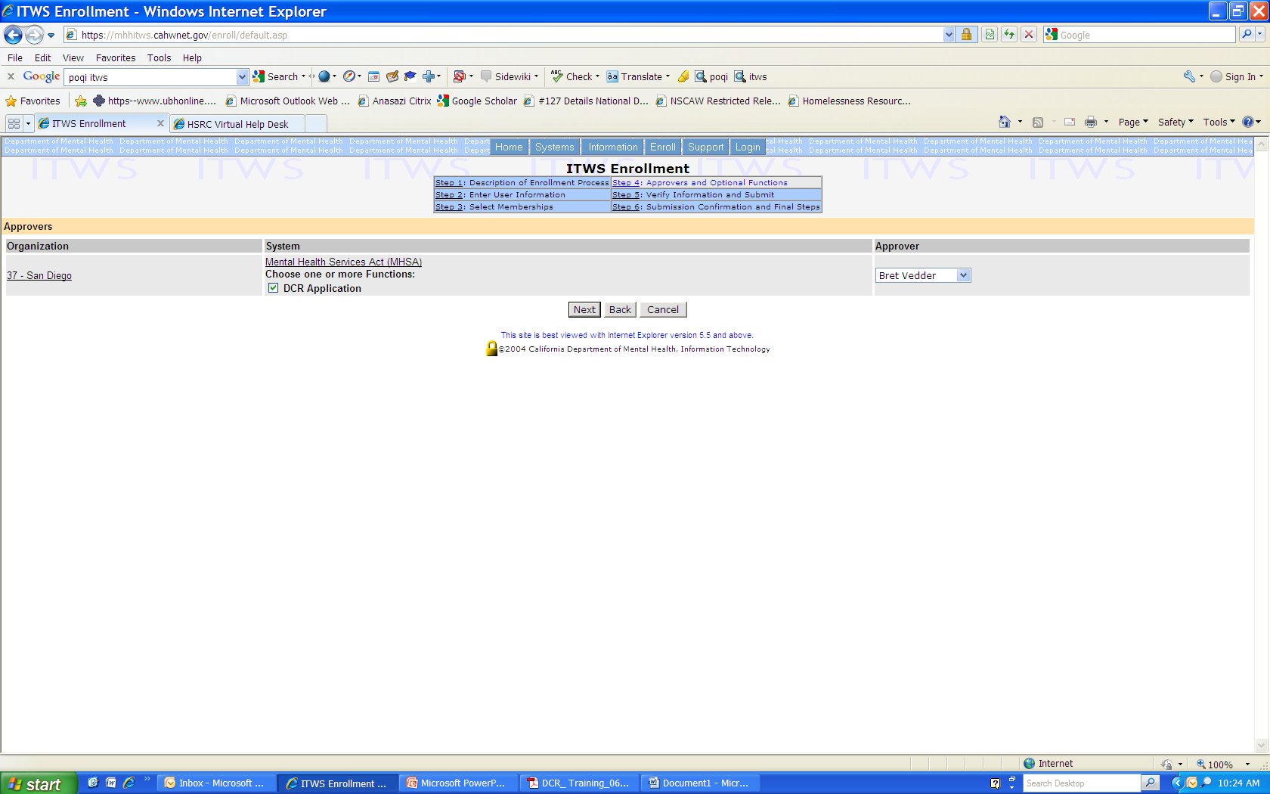
Click on DCR Application

Slide 20
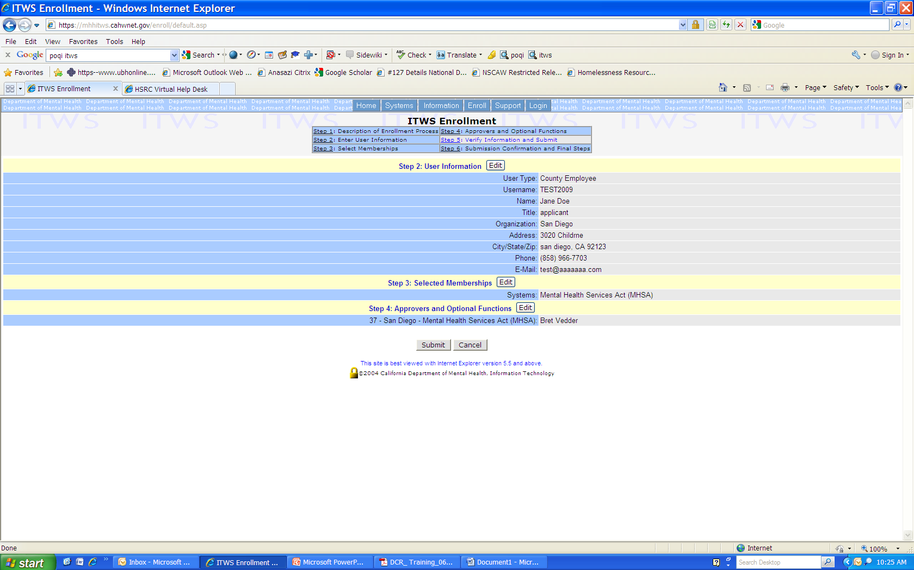
Review data then Submit

Slide 21
Already enrolled in ITWS?
Need to add Access to the DCR

Slide 22
Already enrolled in ITWS?
Enter username and password

Slide 23
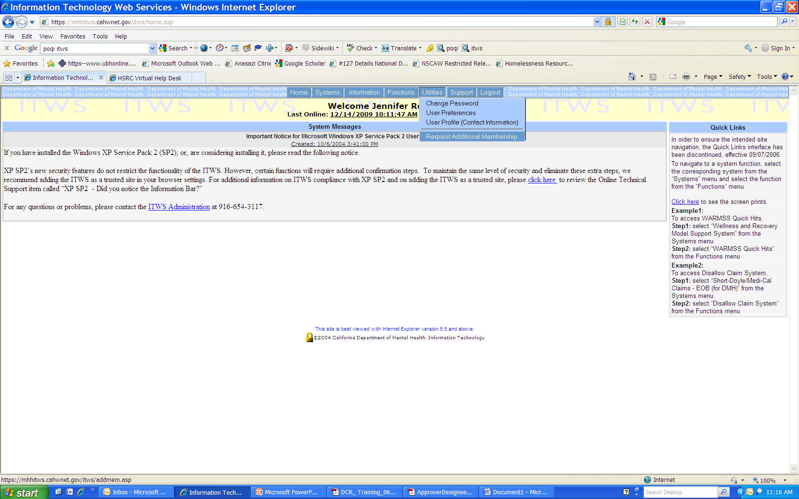
Click Utilities
Select Request Additional Membership

Slide 24
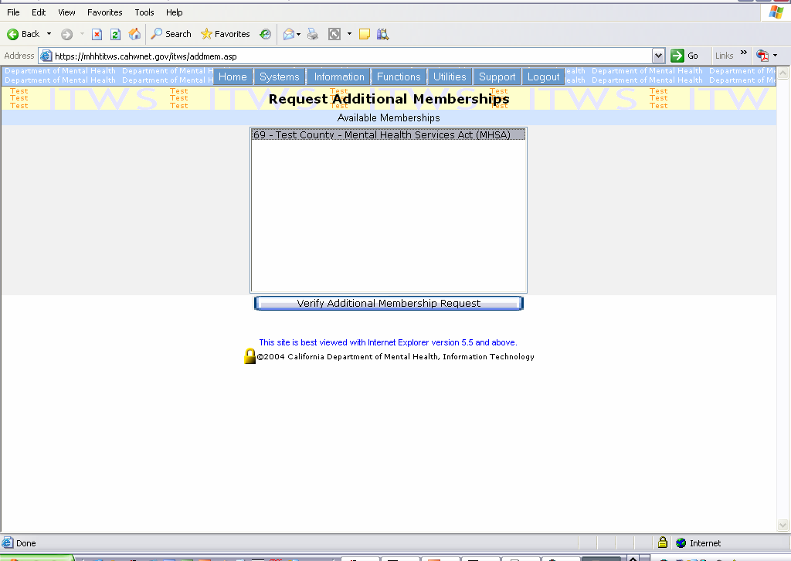
Select MHSA

Slide 25
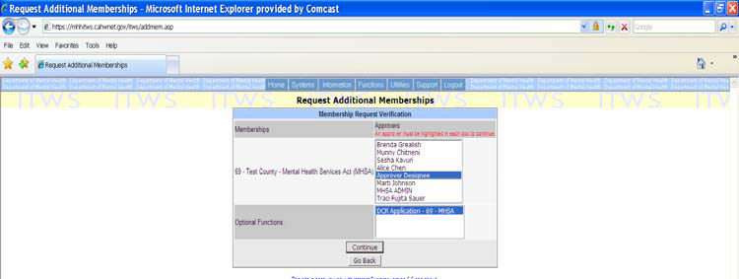
Select Bret Vedder as Approver
Select the DCR Application

Slide 26
Problems with ITWS Enrollment
ITWS Help Desk
ID’s, Passwords, Connectivity, Encryption
itws@dmh.ca.gov
(916) 654-3117

Slide 27
How to access the DCR to enter data

Slide 28
Enter username and password

Slide 29
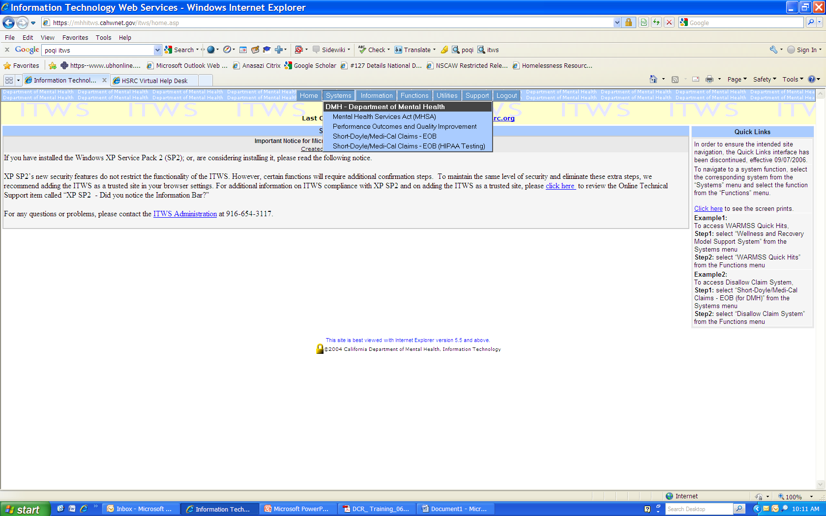
Click on Systems
Select MHSA

Slide 30
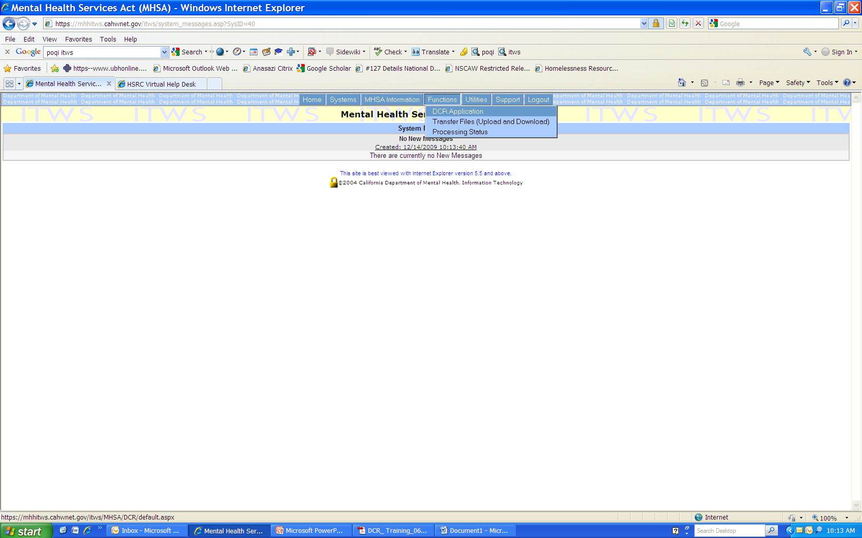
Click on Functions
Select DCR Application

Slide 31
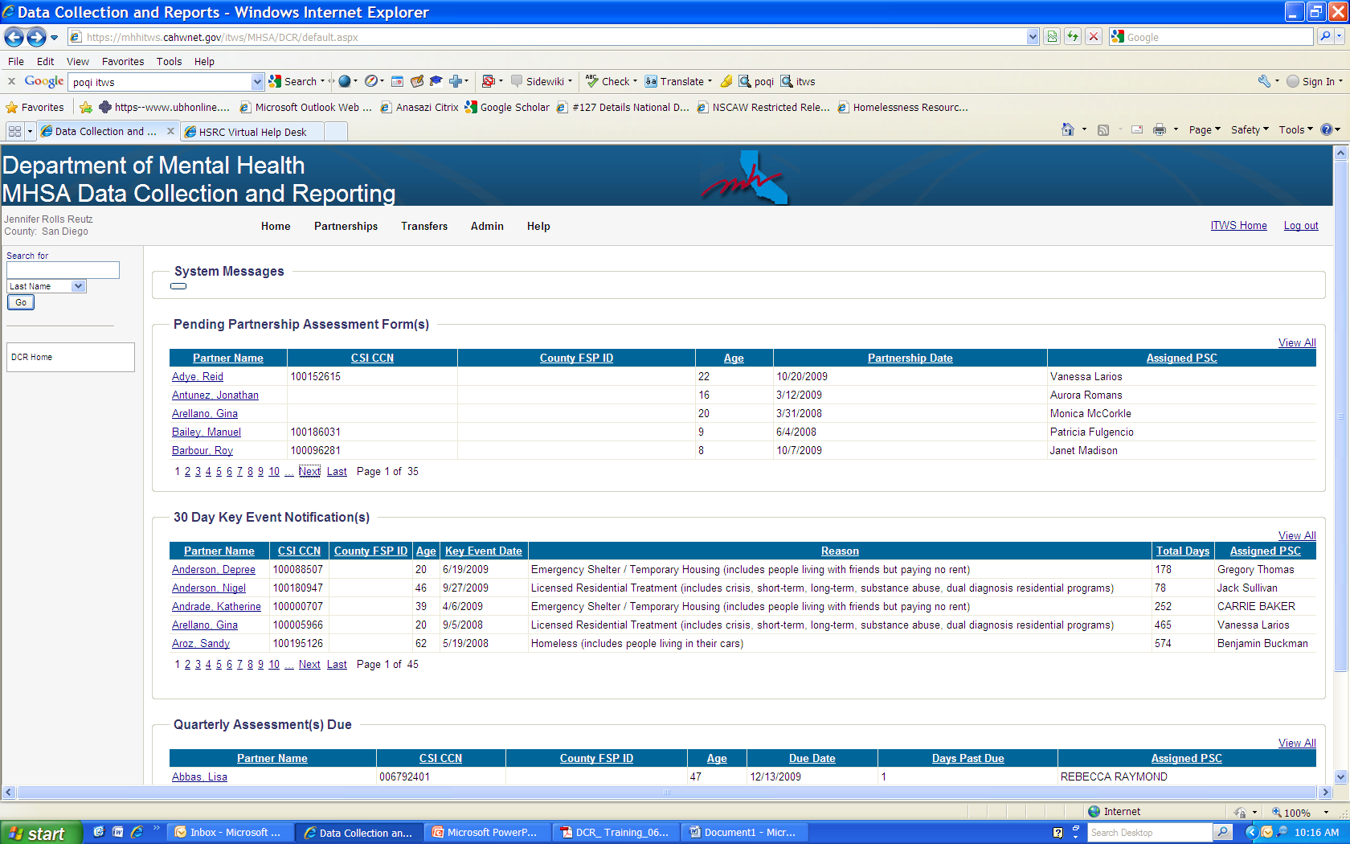
You are now logged in – this is the DCR home screen

Slide 32
Introduction To DCR Messages and Displays

Slide 33
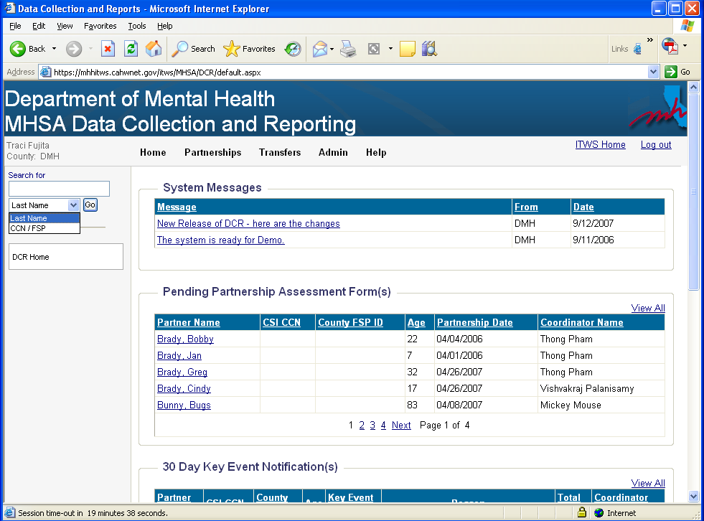
To search for a Partner in the “Search for” box, use the drop-down list to indicate the search criteria:
• Partner’s last name
• CCN / County FSP ID
Click on any underlined heading in any table to sort the displayed information.

Slide 34
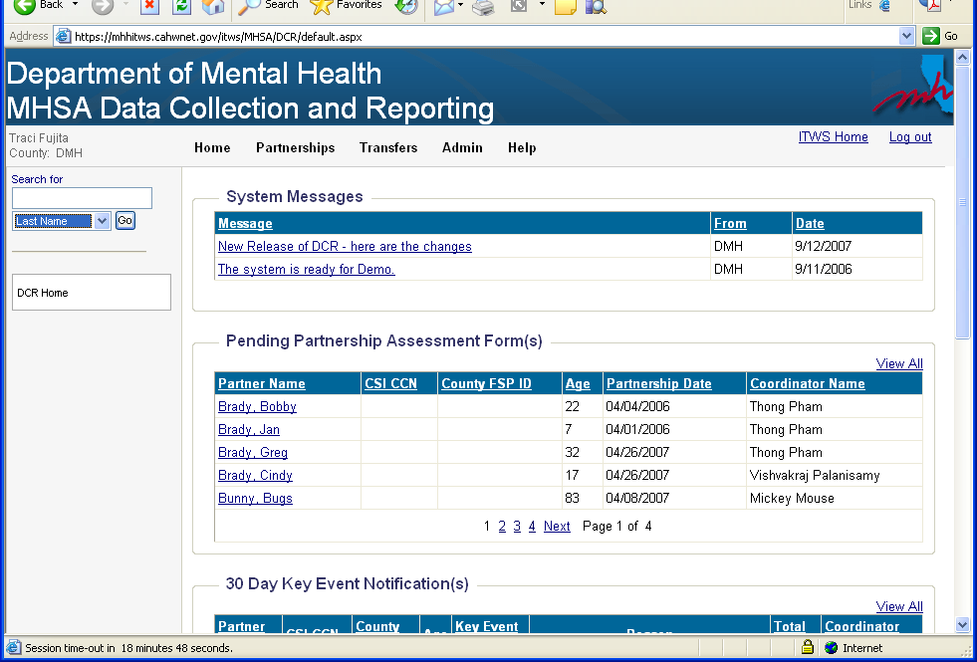
Click on
VIEW ALL to see a larger
view of the
table.
All tables are collapsed. Click on
individual page numbers, “Next” or “Last” (not shown) to see additional data. OR….

Slide 35
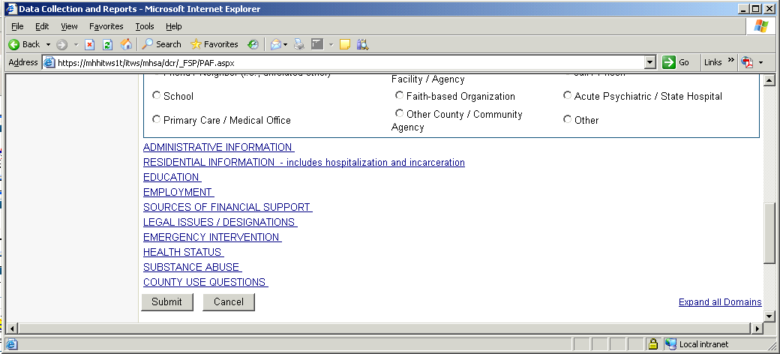
Within forms, domain
headings will be
collapsed. You can
expand a domain by
clicking on each domain
heading. Or . . .
You can also click on the “Expand all
Domains” link at the top and bottom of the screen to expand all
domains at once.

Slide 36
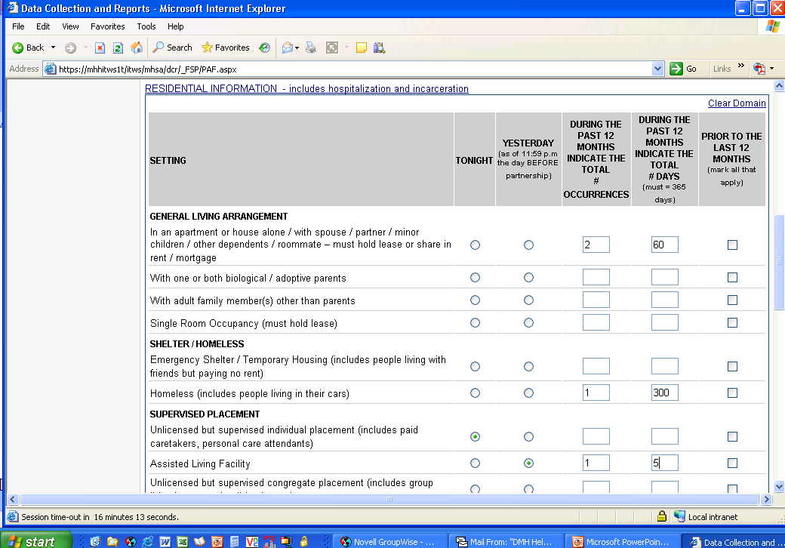
If you make a small mistake, go back and correct the error(s) OR, if
you made mistakes
throughout the domain, click on the “Clear Domain” link at the top of each domain to ERASE
the data entered for that ENTIRE domain.

Slide 37
The left corner of your screen
will indicate a timer. The DCR
will “time-out” in 20 minutes if
there is no activity. (Typing
data is NOT “activity.”)
“Activity” = saving/submitting
data, generating a form,
changing screens, searching
for partners, sorting records,
etc.

Slide 38
When the DCR is close to timing out, a five minute countdown will be displayed. Click “Yes” to restart the 20-minute timer.

Slide 39
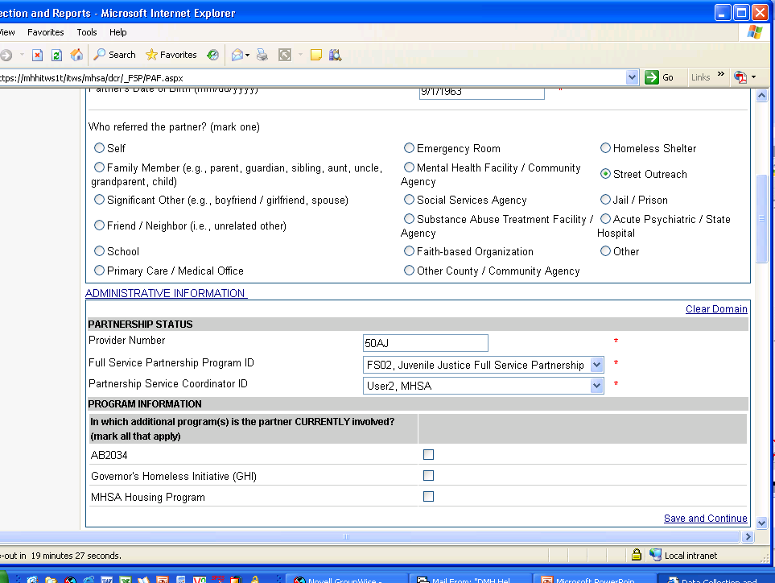
When you are finished entering
data for each domain, click on the “Save and Continue” link at the end of each section to ensure that your data are not lost. This will also reset the 20-minute timer.

Slide 40
DCR Home
First screen you see when you enter the DCR
Also accessible using the menu by clicking “Home” →“DCR Home”

Slide 41
This is the DCR home screen
Indicates the following information:
•User’s Name
•County for which you are submitting data

Slide 42
System Messages
•Displays messages from DMH
•Displays messages from County Administrators

Slide 43
DCR Home Screen (cont.)
Pending Partnership Assessment Form(s)
Displays all PAFs for partners in your group that are not yet complete (i.e., information is missing/incorrect).
Click on the partner’s name to enter additional PAF data.
Once a PAF is complete, the partner’s name will disappear from the ‘Pending Partnership Assessment Form(s)’ table.

Slide 44
DCR Home Screen (cont.)
30 Day Key Event Notification(s)
Displays all KETs for partners in your group that have been in one of the following residential settings for 30 days or longer:
Emergency Shelter /Temporary Housing
Homeless
Acute Medical Hospital
Acute Psychiatric Hospital / Psychiatric Health Facility
State Psychiatric Hospital
Juvenile Hall / Camp / Ranch
Division of Juvenile Justice
Jail
Click on the partner’s name to view the original KET that generated the notification.

Slide 45
DCR Home Screen (cont.)
30 Day Key Event Notification(s), continued…
Ignore the notification if the FSP’s residential status has not changed.
If the residential status has changed, a KET must be completed indicating the date of the residential change, as well as the new residential status.
To update the KET with the FSP’s NEW Residential Information, a NEW KET must be completed.
This will be covered in a later section, called “Entering a Key Event Tracking (KET) Form.”

Slide 46
DCR Home Screen (cont.)
Quarterly Assessment(s) Due
Displays Quarterly Assessments that are due for partners in your group.
Notifications will appear 15 days prior and 30 days after the FSP’s Quarterly Assessment due date.
Click on the partner’s name to enter Quarterly Assessment data.
Note: The Quarterly Assessment information must be collected within this 45-day window, however, data entry may still occur after this 45-day window has passed.

Slide 47
MANAGE ACTIVE PARTNERS
Accessible by clicking on the menu “Partnerships”>“Manage Active Partners”
Displays all active partners that belong to your group

Slide 48
Manage Active Partners (cont.)
Indicates the
PSC assigned
to the Partner.
Indicates which
Partner’s PAF
forms are not
complete.

Slide 49
Manage Active Partners (cont.)
Click on a partner’s name to view his/her assessment history

Slide 50
Manage Active Partners (cont.)
Access entry screens to submit
NEW records.

Slide 51
Manage Active Partners (cont.)
Access “history” links to VIEW or EDIT previously submitted data. (Note: Information will be
overwritten if you make changes to these.)

Slide 52
ENTERING A PARTNER FOR THE FIRST TIME
Note: A partner’s PAF form must be key-entered into the DCR BEFORE other assessments can be added.

Slide 53
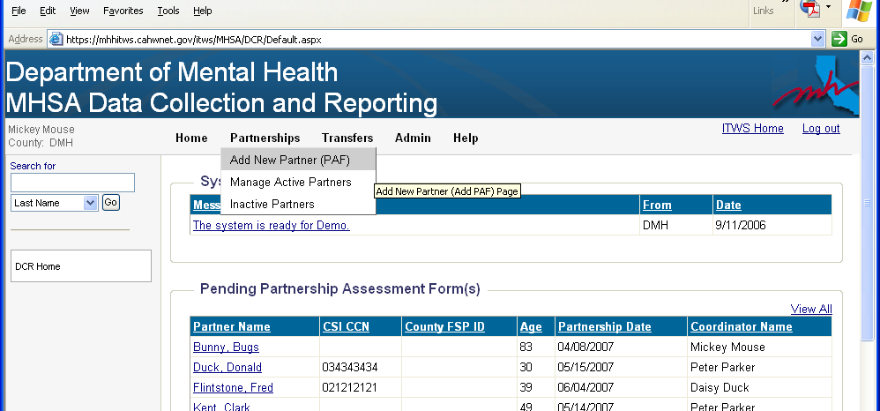
Adding a new partner:
On Home screen, Go to the PARTNERSHIPS menu option
Select “Add New Partner (PAF)”

Slide 54
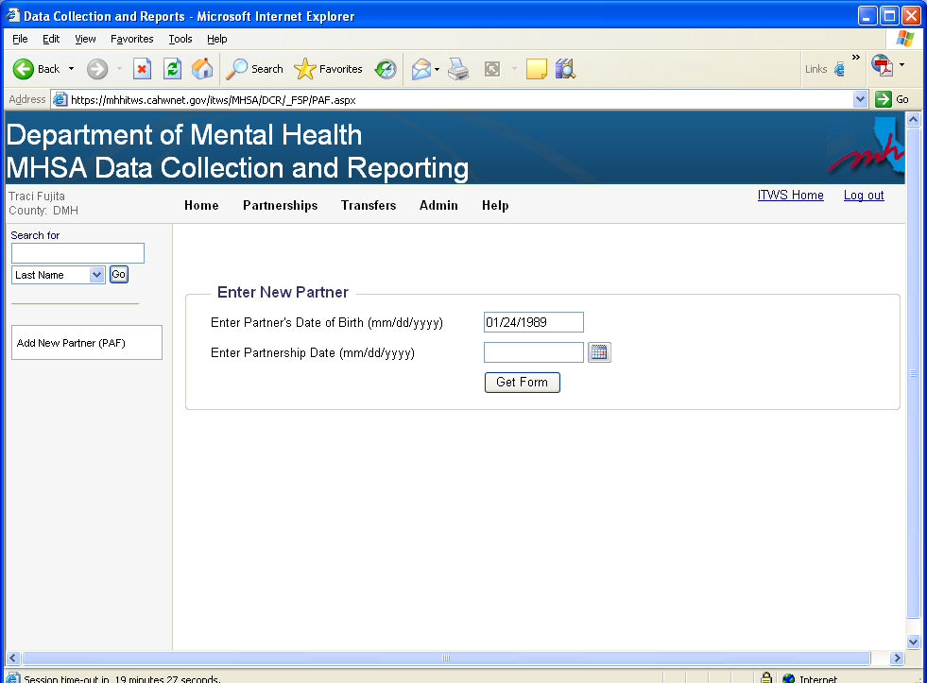
Adding a new partner:
• Key-enter the Partner’s Date of Birth
(format: mm/dd/yyyy)

Slide 55
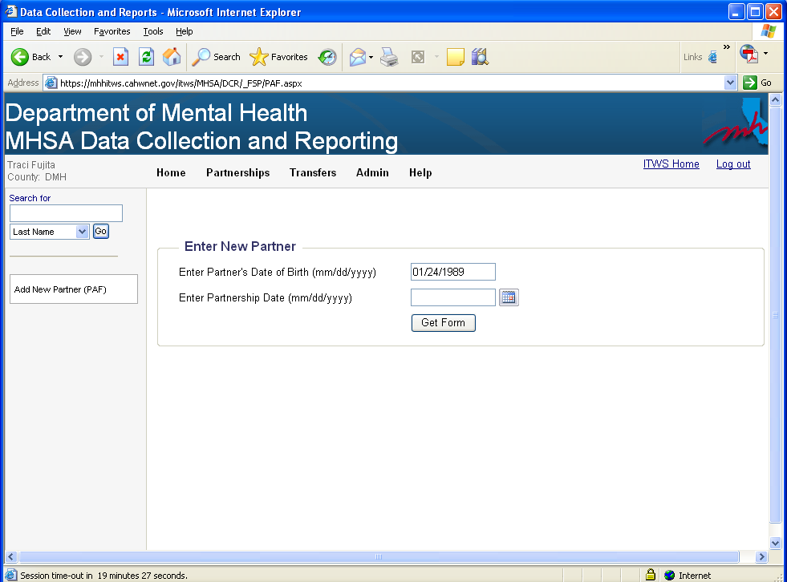
Adding a new partner:
•Enter the Partnership Date by clicking on the calendar icon next to the “Partnership Date” field

Slide 56
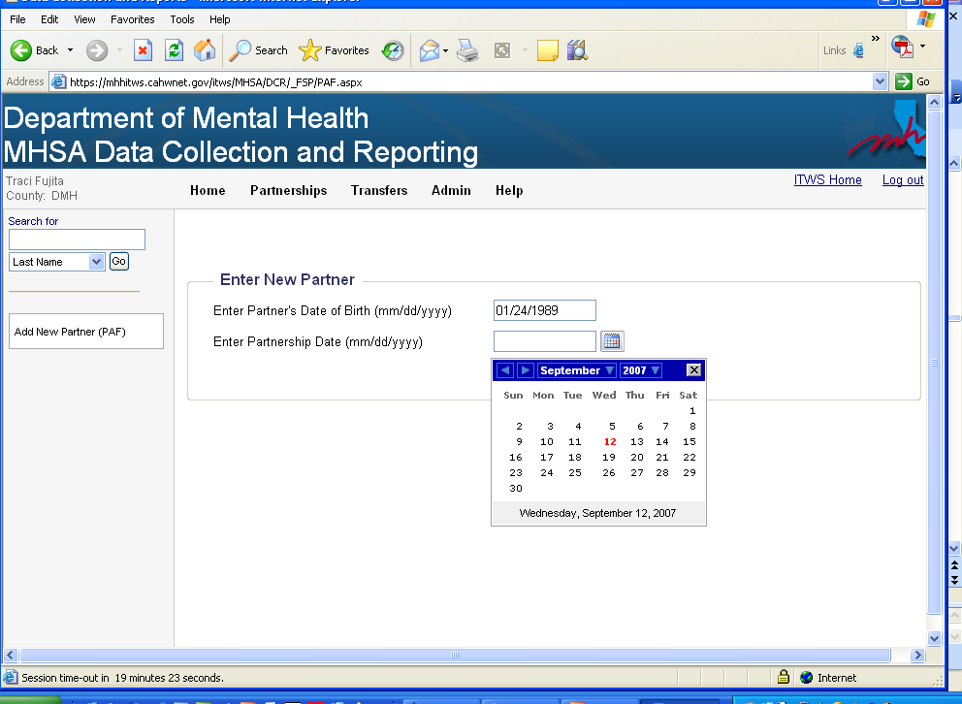
Adding a new partner:
•Enter the Partnership Date

Slide 57
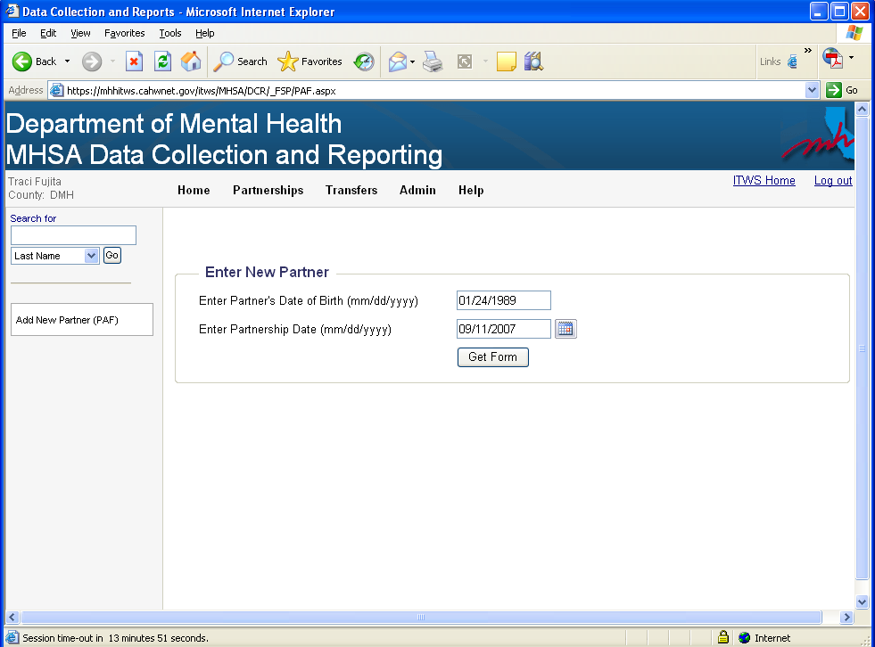
IMPORTANT!
Confirm that the correct dates were entered for the FSP. If
incorrect, retype the dates or go into the calendar to make
corrections. The DCR will select the appropriate form
based on the FSP’s date of birth and partnership date that
was just entered.
If dates are correct, click “Get Form”

Slide 58
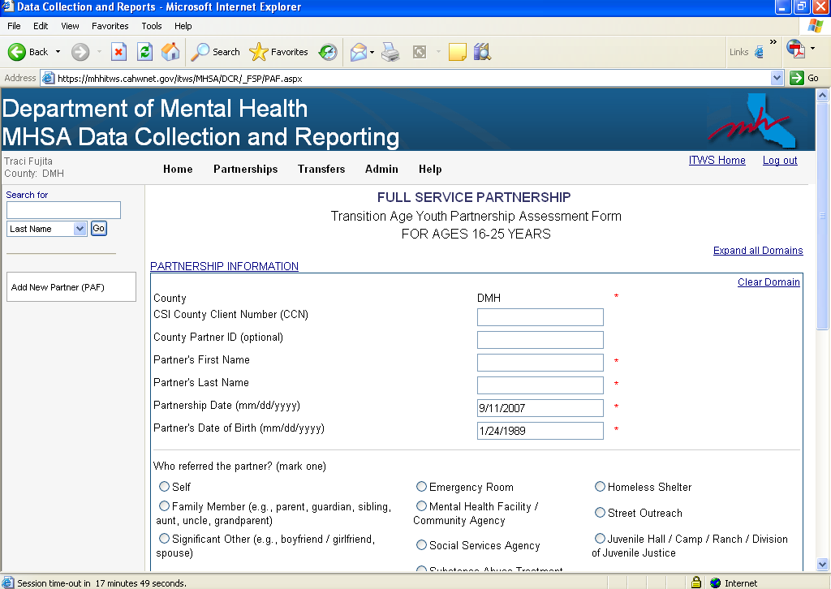
Notice that the age-appropriate
PAF was created.
Items marked with a RED asterisk (*)
are required in order to save the PAF
with, at least, a status of “Pending.”

Slide 59
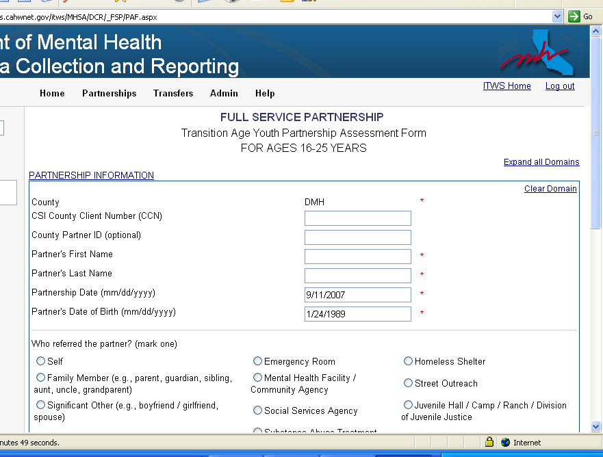
The DCR will notify you if the CSI number you entered
matches our records. If it doesn’t, verify that the number you
entered is correct. If the number is correct, then our records
may not have been updated yet. (There may be a lag between
when a county generates a CCN and when that number is
reported to DMH.) The system will accept the number if a
match is not found.

Slide 60
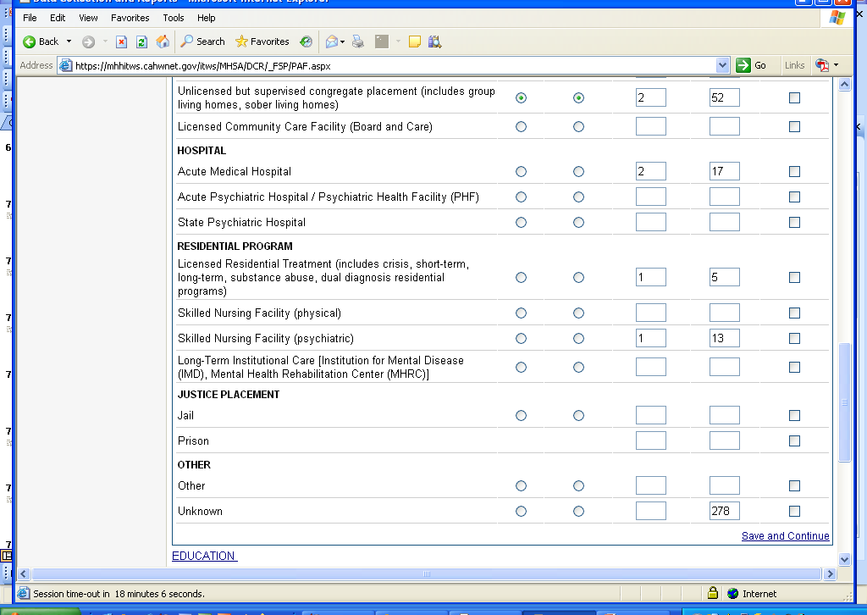
In the Residential Information section, as the total number
of days in each residential setting is entered, a counter in the “Unknown” field displays the number of days that have not been accounted for.
The total number of days must equal 365 days.

Slide 61
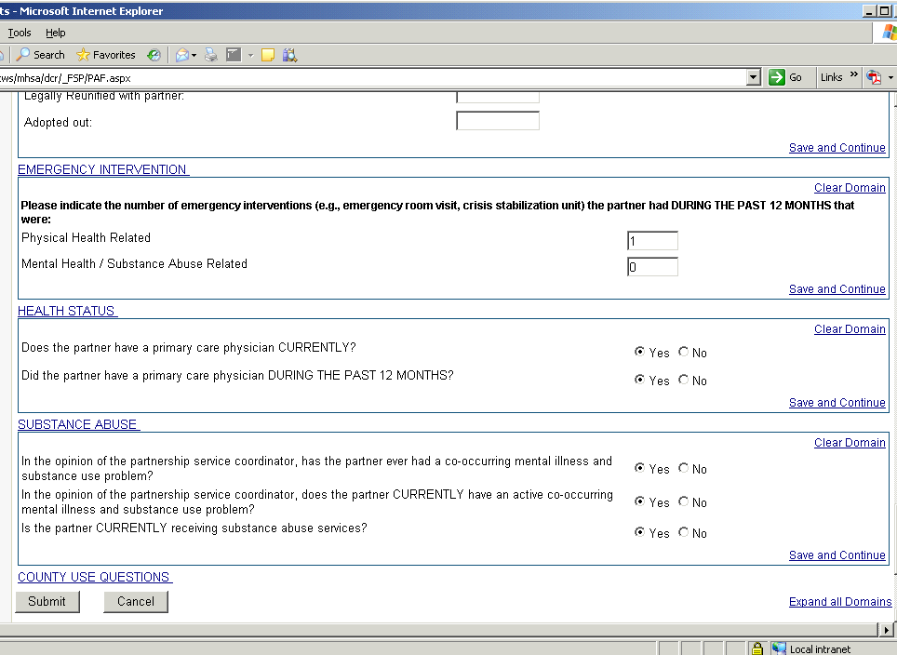
When you have
finished entering data
click on the “Submit”
button to save all of
your work into the DCR.

Slide 62
If the PAF form you are trying to SAVE/SUBMIT is not complete, you will receive the following message:
“OK” = PAF will be saved with a “Pending” status
“Cancel” = Will allow you to go back to the PAF and look at the Validation Report

Slide 63
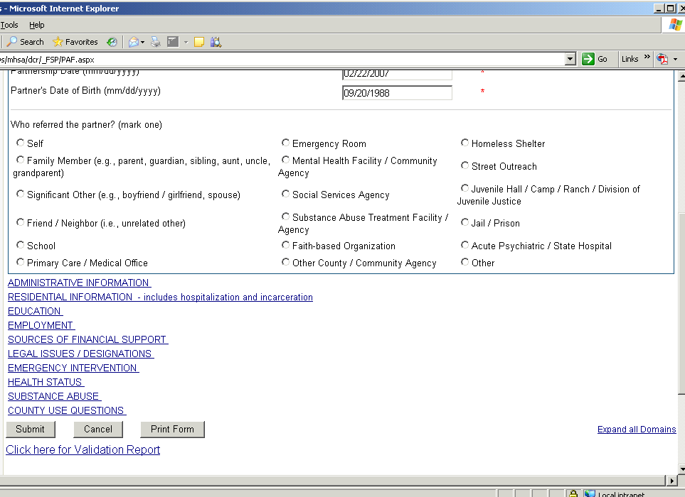
Click on the link to
access the Validation
Report.
(The Validation Report
is also available from
the “Manage Active
Partner’s” screen.)

Slide 64
Sample Validation Report. Indicates missing/incorrect
information. (Keep in mind, generally all questions that are not
conditional require some type of response. This report will tell you
which questions need to be answered before the PAF can be
considered “Complete.”)

Slide 65
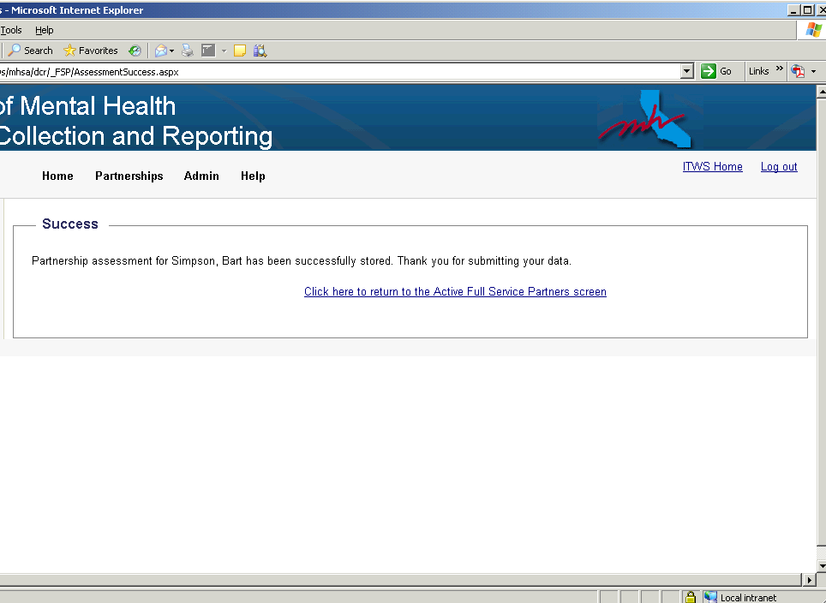

Slide 66
ENTERING A KEY EVENT TRACKING (KET) FORM

Slide 67
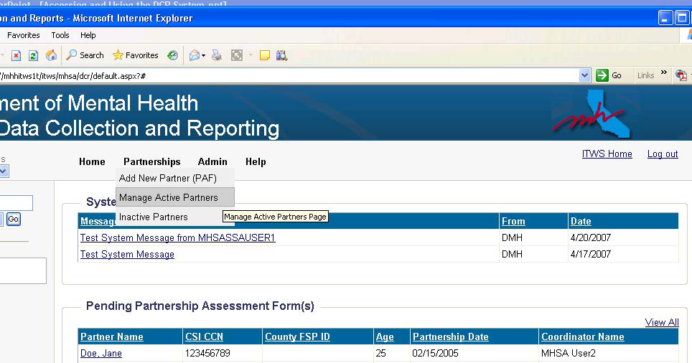
Entering a Key Event Tracking (KET) form:
•Go to the PARTNERSHIPS menu option
•Select “Manage Active Partners”

Slide 68
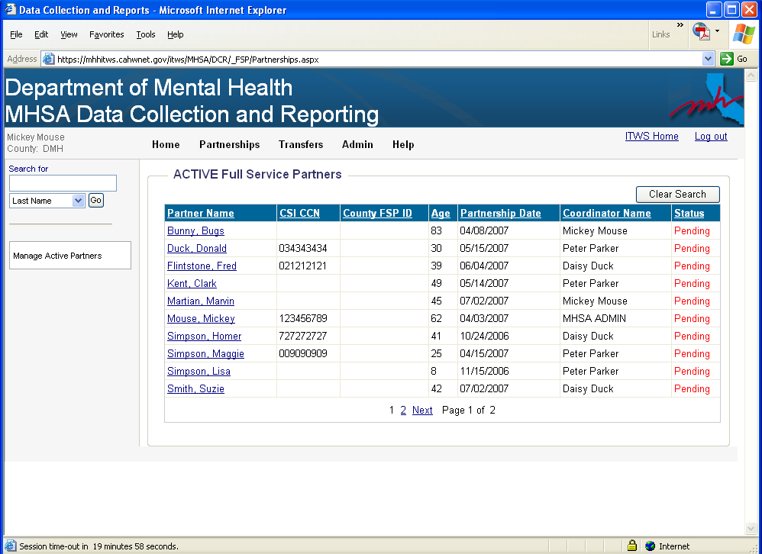
Click on a Partner’s name to access
their records.

Slide 69
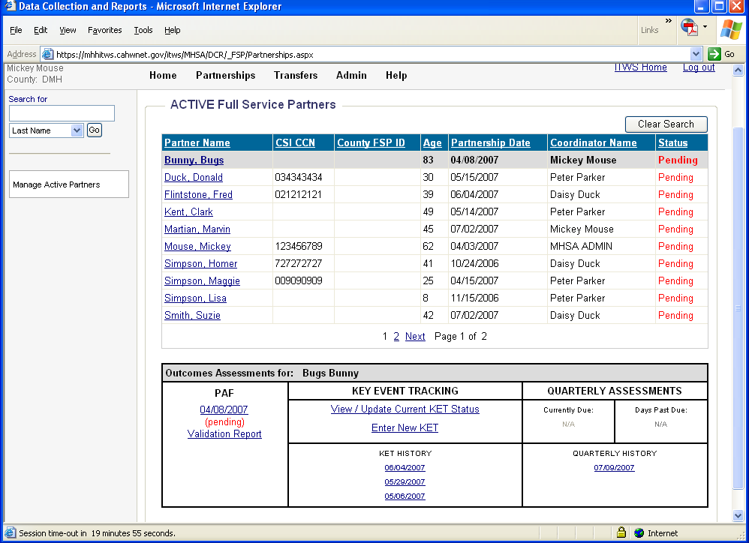
There are two ways to enter a KET:
1. Click “View / Update Current KET Status”
OR
2. Click “Enter New KET”

Slide 70
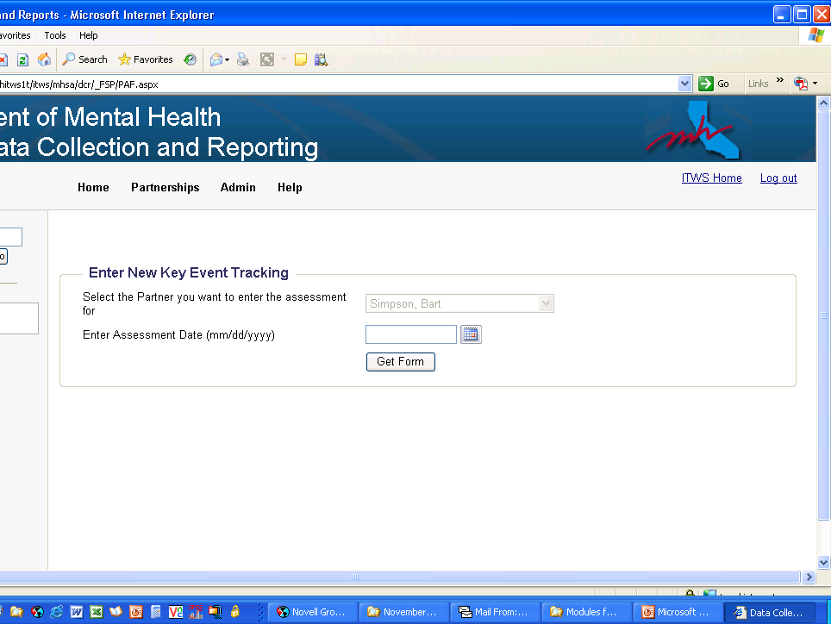
Enter the Assessment Date
& click on “Get Form”

Slide 71
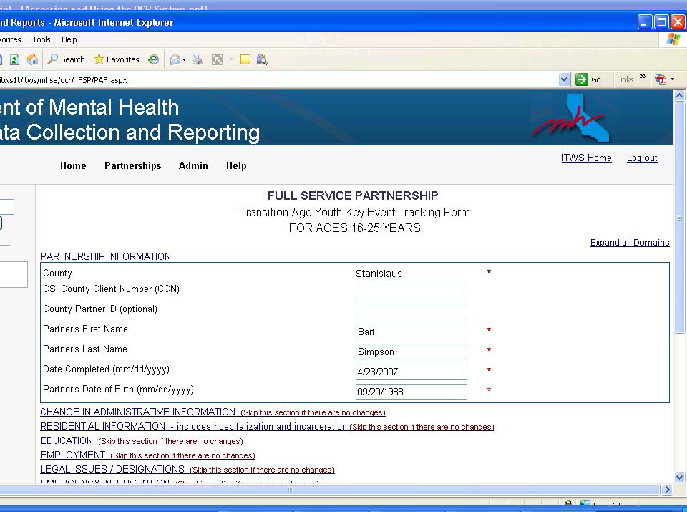
Enter information for what changed.
Exception: Educational and Employment Setting
questions are “snapshots” and, if there are changes to these
questions, you also need to indicate their current situation
(which includes new and ongoing statuses).
Example: Client was working 5 hours a week at Job A. Now also working 5 hours a week at Job B. Enter both jobs on KET.

Slide 72
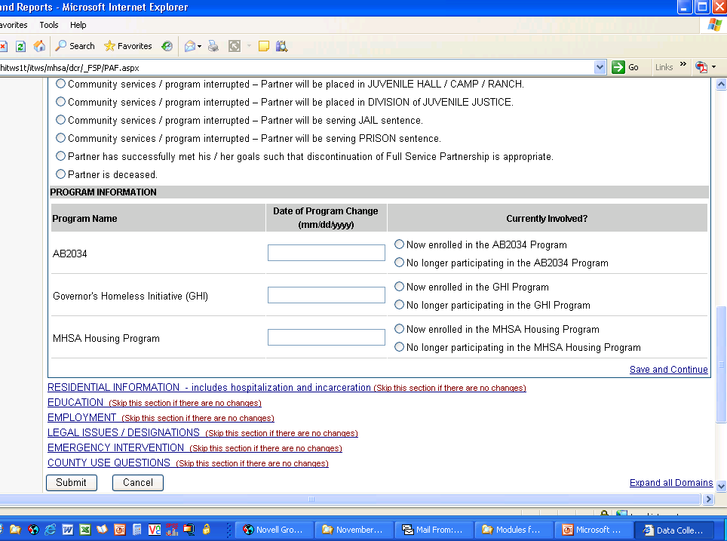
Click on “Submit”
when done.

Slide 73
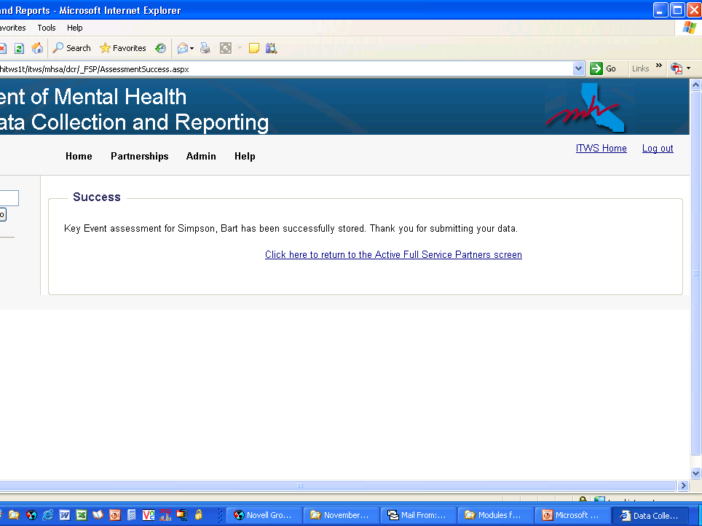

Slide 74
ENTERING A QUATERLY ASSESSMENT (3M) FORM

Slide 75
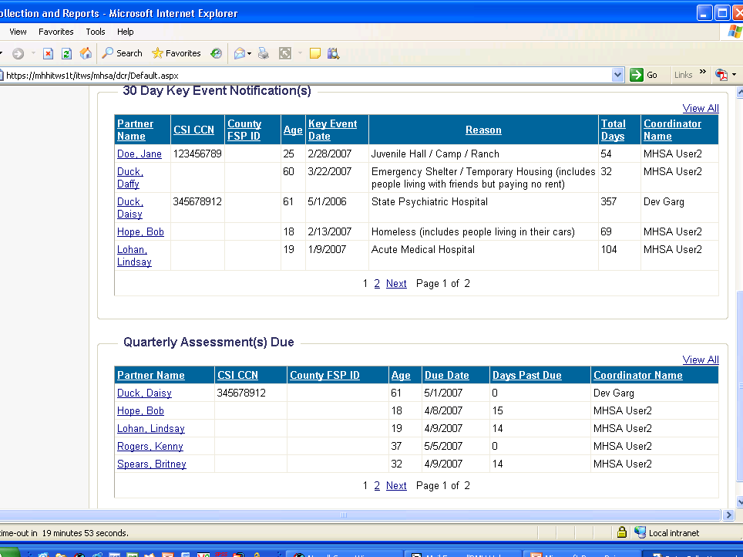
The Quarterly Assessment
notification on the DCR Home
page indicates who is due for a
quarterly assessment.
(Notification appears 15 days
prior to the due date and 30
days after the due date.)
Click on a name to enter the
information. OR . . .

Slide 76
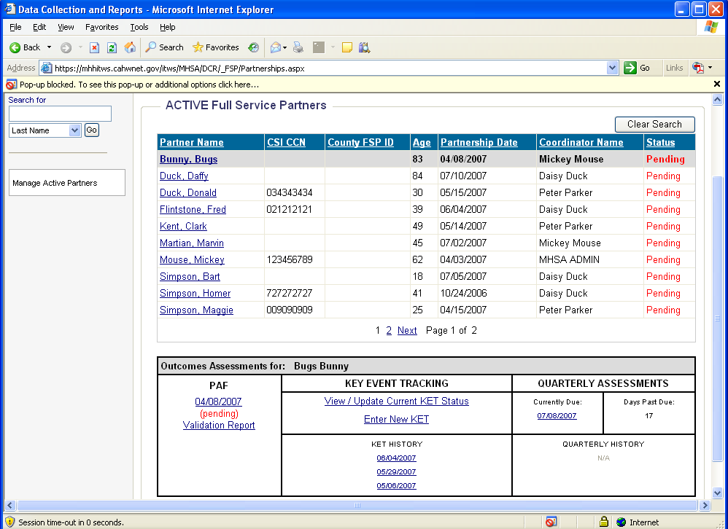
The Quarterly Notification
also appears when you
access a Partner’s records
from the Manage Active
Partners screen.
Click on the link to enter the
information. OR . . .

Slide 77
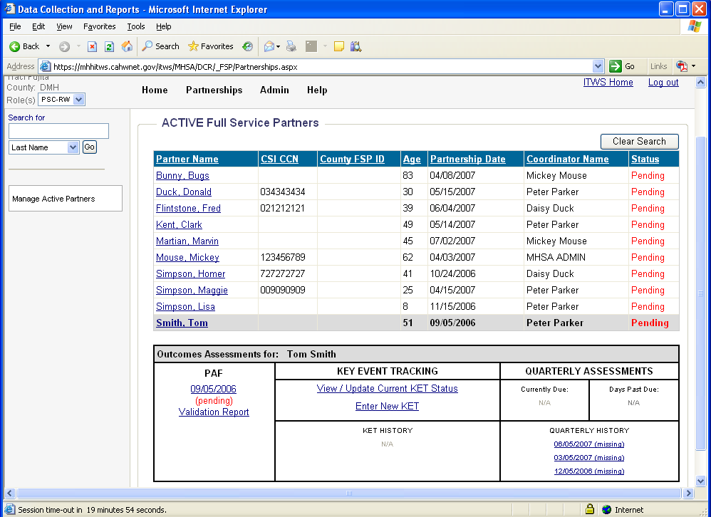
If the Quarterly Assessment was COLLECTED from the partner WITHIN the 45-day window (15 days prior to the due date or 30 days after the due date) but was not ENTERED, the link for the past-due assessment may be accessed in the Quarterly Assessment History section.
NOTE: The Quarterly Assessment data must be collected within the 45-day
window, but the data can be entered beyond the 45-day window.

Slide 78
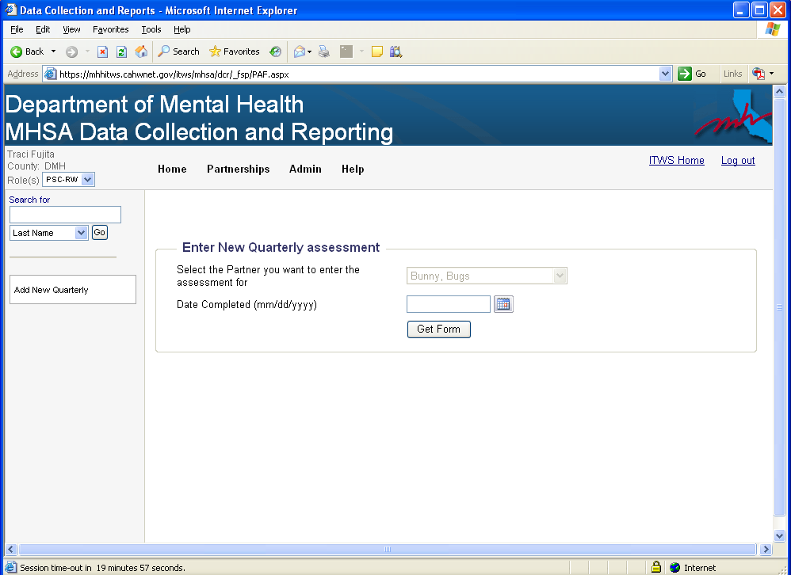
Enter the Assessment Date
& click on “Get Form”

Slide 79
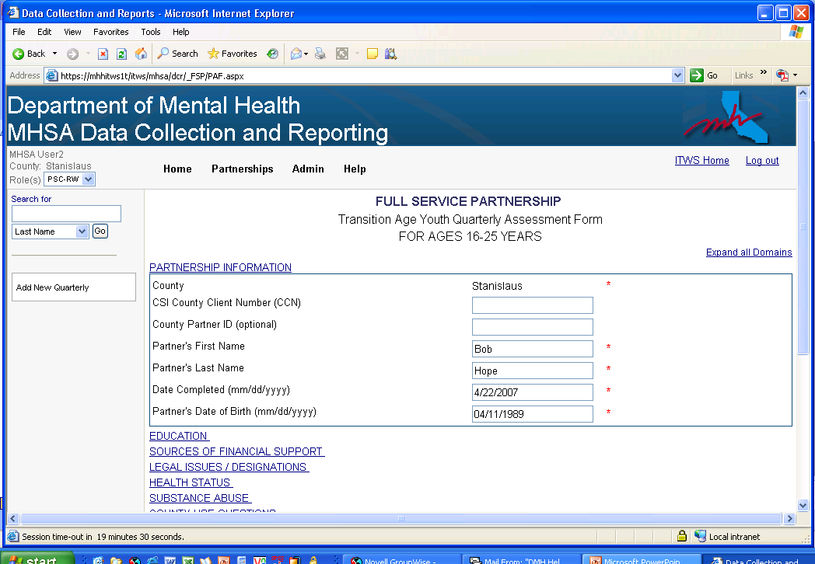
Unlike a KET, ALL domains
should be completed.

Slide 80
REVIEW: Entering Data into the DCR
For a specific client, enter all PAF information first.
Data entry for PAFs must be accessed via PARTNERSHIPS > ADD NEW PARTNER
Data entry for KET / Quarterly Assessments may be accessed via PARTNERSHIPS > MANAGE ACTIVE PARTNERS

Slide 81
TECHNICAL INFORMATION
DCR System Requirements
The DCR development team has identified the following
requirements and settings to insure a positive experience
when using the DCR system:
Use Windows XP
Use Internet Explorer 6.0 or above (other browsers are not supported)
Set https://mhhitws.cahwnet.gov/ as a trusted site with
settings set to medium
Allow cookies from https://mhhitws.cahwnet.gov/
Allow pop-ups from https://mhhitws.cahwnet.gov/ (many messages in the DCR are presented in pop-ups)

Slide 82
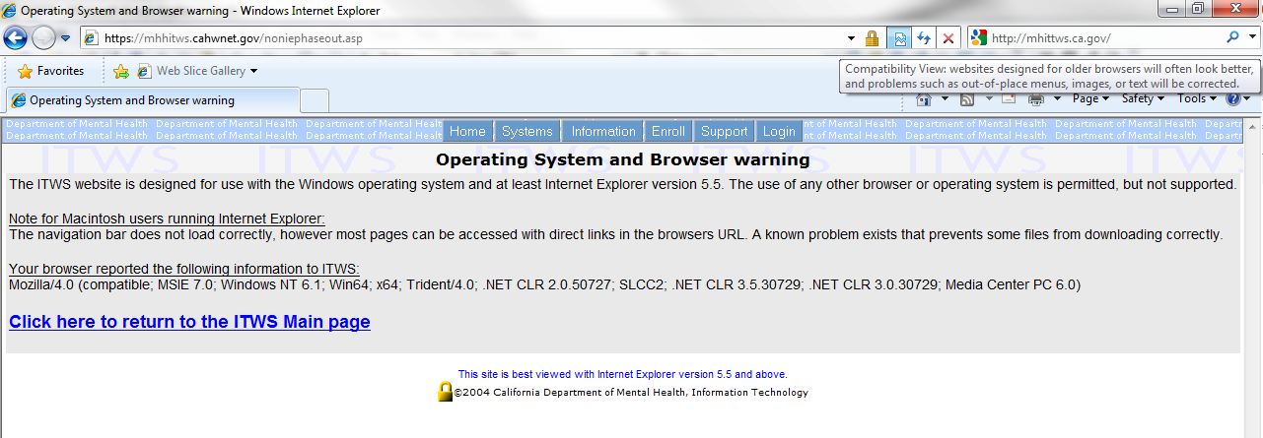

Slide 83
What if you have questions?
Problems enrolling in ITWS:
Contact Bret Vedder, SD County Approver Designee
Contact ITWS System help Desk:
Phone: (916) 654-3117
Fax: (916) 654-3007
Email: itws@dmh.ca.gov

Slide 84
What if you have questions?
Questions about using the DCR:
1) Look first for the answer to your question in your printed copy of the "Companion Guide to the DCR."
2) Look in our frequently asked questions (Http://hoap.ucsd.edu/fsphelp) 3) If you can't find the answer in either of those places try the more detailed “Accessing and using the Data Collection and Reporting (DCR) system,“ found on the “Data entry resources" button of the HSRC Help page. 4) If you cannot find your answer in any of these online resources, then please contact your appropriate "Approver Designee(s)“ at the County.
5) Approver Designees report program's questions and their answers to HSRC and we include them on our FAQ, thus lessening the burden on the Approver Designee(s).

Slide 85
What if you have questions?
Questions about using the DCR:
Visit the HSRC Virtual Help Desk:
http://hoap.ucsd.edu/fsphelp/
Links to data on POQI website
Companion Guide for Full Service Partnership Outcomes Assessments
Links to where to download forms (PAFs, 3Ms & KETs)
FAQ section is very helpful and improving through your input!

